Slide 1
The Argumentative Essay

Slide 2
Topic Objectives
Understand what an argumentative essay is
Learn argumentation strategies
Know the mistakes to avoid
Practice creating argument statements

Slide 3
Purpose of Argumentative Writing
To have the reader seriously consider your point of view*
HOW?
Organize and present a well-reasoned point of view

Slide 4
Argumentative Essays should:
Logically Defend, Support, or Refute
Have a Well-Reasoned Conclusion
a) Opinions b) Viewpoints c) Ideologies
step by step, guide the reader through logic with illustrations and explanations so that the conclusion seems inevitable

Slide 5
What is not Debatable?
Opinions grounded in emotions
Religion

Slide 6
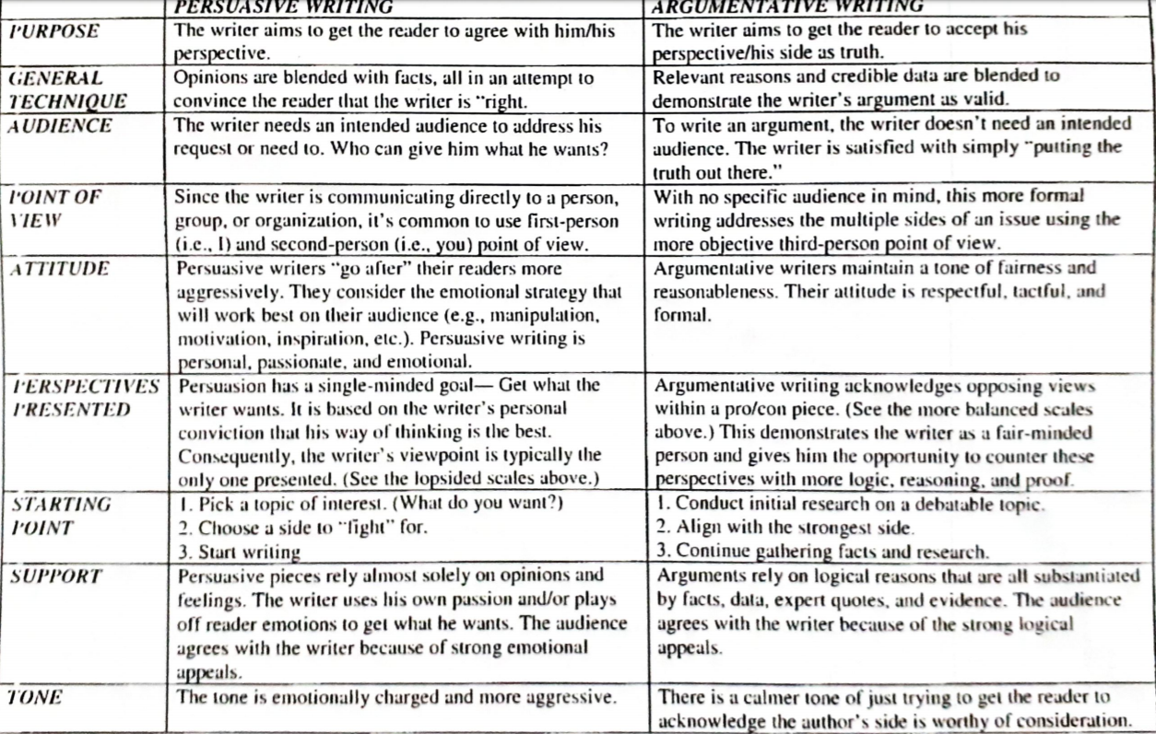

Slide 7
Comparison of Features
Argumentative Essay
Presents robust, non-selective data
Aims for intellectual engagement
objective evidence [logos]
Assumes that the audience is informed and skeptical
Links claim and evidence with counterargument
Persuasive Essay
Presents Selective data
Aims for emotional resonance and persuasion
Makes claims compelling & downplays counter-aruguments
Emotional appeals [pathos], & Credibility appeal of the author [Ethos]
Assumes the audience is less informed and persuadable

Slide 8
To Develop a Strong Argumentative Thesis:
a. Be Specific:
Avoid vague claims; clearly state your position and what the essay will address.
b. Be Debatable:
Ensure your thesis presents an argument that could be contested.
c. Match Scope to Essay Length:
A thesis for a short essay should be narrower, while a longer essay can handle broader claims with multiple supporting points.
d. Integrate Counter-arguments (if needed):
Acknowledging opposing views can make your thesis more nuanced and credible.

Slide 9
Comparing Thesis Structures
Topic: Should AI development be regulated?
Argumentative:
Presents a detailed case for and against regulation using research, addressing both technical and ethical dimensions.
Persuasive:
Focuses on the risks of unchecked AI, using vivid scenarios to provoke concern and inspire advocacy for regulation.

Slide 10
Possible Structures of an Argumentative Essay
Structure one:
(Expository essay format)
Introduction & Thesis statement
Conclusion
Structure Two
(Block Format):
Introduction & Thesis statement
Conclusion
1st Body paragraph
{Main point+ supporting evidence
2nd Body paragraph
{Main point+ supporting evidence}
3rd Body paragraph
{Main point+ supporting evidence}
4th Body paragraph
{Main point+ supporting evidence}
1st Body paragraph
Refute 1st opposing point
2nd Body paragraph
Refute 2nd opposing point
4th Body paragraph
Present your 2nd point + supporting evidence
3rd Body paragraph
Present your 1st point + supporting evidence
Structure Three
(Chain Format):
Introduction & Thesis statement
conclusion
Present 1st point and its supporting detail also refuting 1st opposing claim
Present 2nd point and its supporting detail also refuting 2nd opposing claim
Present 3rd point and its supporting detail also refuting 3rd opposing claim

Slide 11
Sample Thesis
Although some argue that regulating AI could hinder innovation and delay advancements, such regulation is essential to mitigate ethical concerns and protect privacy, as these measures ensure technological progress aligns with societal values and safeguards individual rights.
AI development must be regulated to address ethical dilemmas, safeguard privacy, prevent job displacement, and ensure responsible innovation, as these measures are critical for balancing technological progress with societal well-being.
While proponents argue that unregulated AI fosters innovation, the potential harms to ethics and safety necessitate regulatory measures.

Slide 12
Logical Fallacies
Fallacy
Argument ad hominem | Attacking the person instead of the argument. | "You can't trust her argument on climate change; she isn't even a scientist."
Straw man | Misrepresenting someone's argument to make it easier to attack. | "He says we should reduce car use; he obviously wants us to stop driving altogether."
Appeal to Emotion | Using emotions to persuade instead of logical reasons. | "If you care about your family, you'll buy this expensive security system."
False Dichotomy | Presenting only two choices when more options exist | "You're either with us or against us."
Slippery Slope | Arguing that one small step will inevitably lead to an extreme outcome. | "If we allow students to use calculators, soon they won’t learn math at all."

Slide 13
Logical Fallacies
Circular Reasoning | Using the conclusion as a premise without proper evidence. | "We know he’s honest because he always tells the truth."
Hasty Generalization | Making a general statement based on insufficient evidence. | "I met two rude doctors; therefore, all doctors are rude."
Red Herring | Diverting attention from the actual issue by introducing something irrelevant. | "Why worry about the environment? We should be focusing on reducing unemployment."
Bandwagon Fallacy | Assuming something is true or right because everyone else believes it. | "Everyone is investing in cryptocurrency, so it must be a safe investment."
Appeal to Authority | Claiming something is true because an authority figure believes it, without relevant evidence. | "This medicine must work because a famous actor endorses it."

Slide 14
Logical Fallacies
Post Hoc | Assuming that because one event followed another, the first caused the second. | "I wore my lucky socks, and we won the game. The socks made it happen!"
Faulty Analogy | Comparing two things as if they are the same, despite significant differences. | "If we let people adopt pets, why not let them adopt wild tigers too?"
Appeal to Ignorance | Arguing that something must be true because it hasn’t been proven false (or vice versa). | "No one has proven aliens don’t exist, so they must be real."
Faulty use of Authority | Relying on the reputation or authority of a person instead of presenting factual or logical evidence | This energy drink is the best because my favorite actor says so
Argument ad populum | Appeal to readers’ emotional reaction instead of logic | If you are a true Muslim/Christian/Jew/…., you will vote only for Mr. X in election

Slide 15
Class Activity
The thesis of an Argumentative essay is your opinion. Decide on your opinion and write clear thesis statements for the following essay prompts.
While studying, is technology a distraction?
Does TV promote dangerous stereotypes?
Do rich people get off easier when they break the law?
Can money buy you happiness?
How much does your neighborhood define who you are?

